Slide 1
Group Meeting about Phonons
Jim Antonaglia
8/20/14

Slide 2
Phonons are useful
Phonon dispersion yields information about
  Interparticle potentials
  Crystal structure
  Unit cell structure
Metamaterials just like optical materials
  Phononic band gaps
  Acoustic lenses
  Negative acoustic permeability
Notes:
They give us interesting physics
They give us interesting engineering applications

Slide 3
Phonons are interesting in colloids
Hard/soft spheres in solution make good phononic band gap materials (resonances)
Colloidal systems can reconfigure their structure in the presence of sound waves
Phonons have more or less the same dispersion in dense colloidal crystals as they would in an atomic crystal, but we can activate them with optical wavelengths rather than with neutrons

Slide 4

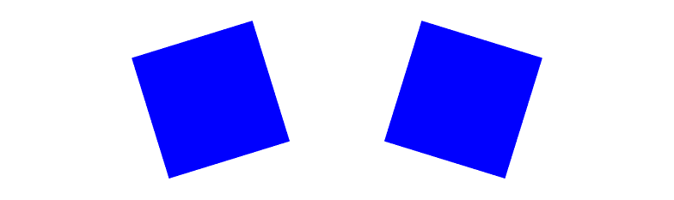
Where can we add shape?
Already seen in molecular crystals:
  They exhibit vibrational modes (phonons)
  Also have librational modes (librons, yes)
  Generally coupled together
A vibrational mode
And a librational one
Notes:
Cubane is a great and illustrative example
C8H8 molecules make an (almost) fcc lattice that changes its rhombohedral angle and lattice constant when rotational degrees of freedom are liberated
Cubane also exhibits librational degrees of freedom and a libron spectrum

Slide 5
Why bother with libration?
They'll show up anywhere the interparticle potential is anisotropic. That is, V(r₁-r₂) cannot be expressed as V(|r₁-r₂|).
If we're going to study sound in crystals of anisotropic particles, we need to know about librons.
Self-assembling acoustic metamaterials
Oh God more linear algebra
Notes:
They arise as technical details in more complex crystal structures
They are also very physically interesting, as they are fundamentally different from phonons

Slide 6

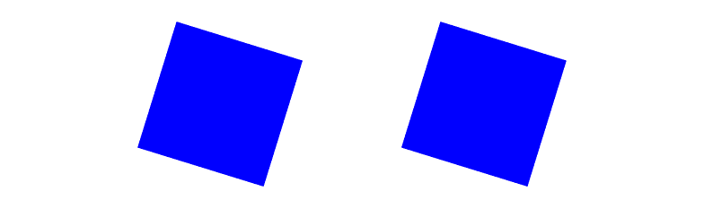
More about librons: they have mass
Vibrational modes
Librational modes
energetic
energetic
not energetic
it depends
Notes:
Top: k \neq 0
Bottom: k = 0

Slide 7
What does mass mean?
Goldstone's theorem: when we break a continuous symmetry, we get a particle:
  Global translational symmetry → phonons, e.g.
In a symmetric rotator phase, the continous symmetry is a local rotational symmetry (i.e. a gauge symmetry)
Solid crystal phase breaks this local symmetry and gives us a massive particle, the libron.
  Same mechanism as BCS superconductivity and electroweak symmetry breaking in Standard Model!

Slide 8
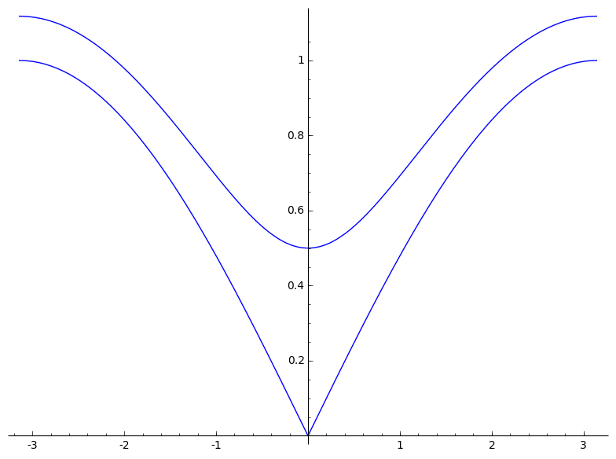
What does mass mean?
It's all in the dispersion relation:
We cannot arbitrarily excite libron modes! We need at least enough energy to provide for its mass.
Particle physics: mass
Condensed matter: band gap

Slide 9
How do we get dispersion in MC?
Correlation functions!
For a quadratic Hamiltonian, we can use the equipartition theorem for any degrees of freedom that we want:
Easier if we (at least partially) diagonalize the quadratic coupling matrix.
So let's go to a Fourier basis!

Slide 10
Fourier is a unitary transformation
All degrees of freedom are coupled together! This means every correlation function will be nonzero!
All the modes with different wave vectors k_{i} are uncoupled, so we don't have to calculate as many correlation functions!

Slide 11
Fourier is a unitary transformation
This is the Fourier transform: x_{i} are the lattice positions, and u_{i} are the small displacements from the lattice positions
In 1D for a single field u, this is easy.
But what about n fields in d dimensions?
This only complicates things a little bit.
The frequency dispersion eigenvalues become a
frequency dispersion matrix.
Notes:
By field, here, what I mean is any quantity that is defined over space. Here, we're working with discrete fields u(r_i), whereas another field like the electric field is over continuous space. The continuum theory of elasticity is generated from here by taking k → 0 and by allowing the number of lattice points to grow to infinity.

Slide 12
Correlation function algorithm
Time average the particles' positions
For each time step, calculate
Using the known lattice vectors, calculate reciprocal lattice vectors and FT the field
Calculate correlation functions such as
Invert this matrix and read off the dispersion relation
For concreteness, let's talk about a specific model

Slide 13
The harmonic crystal
Simple cubic crystal
Nearest neighbors bound with k₁
Next nearest neighbors bound with k₂
Nearest neighbors:
Next-nearest neighbors:
Eigenvalue problem
Crystal lattice details are here

Slide 14
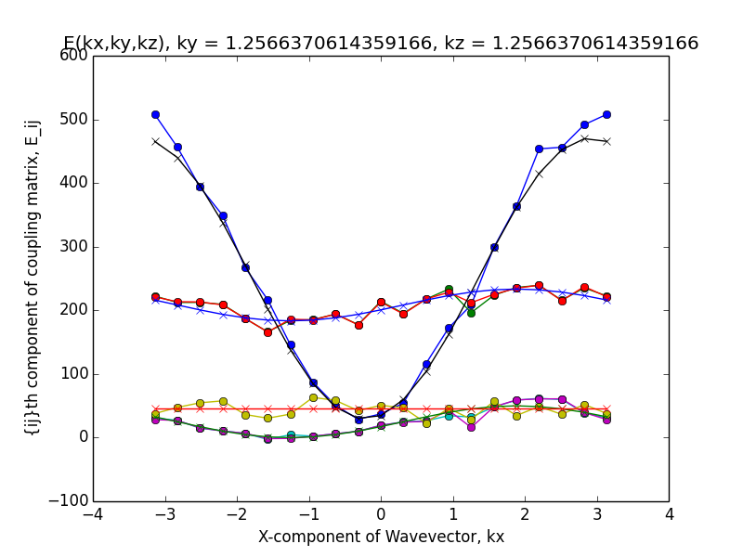
Notes:
N = 20x20x20 = 8000
T = 0.4
Space between particles = 1
Dots = experiment
Xs = theory, with k constants put in a priori

Slide 15

2-D hard hexagon crystal
Start with a nearest neighbor approximation:
What do the stiffness constants mean? There's an effective crystal potential that we can expand about a known minimum.
The packing fraction at which the libron dispersion vanishes corresponds to the point where local rotational invariance is restored.
Notes:
We expect a density where the hexagons can all rotate freely yet remain tightly enough in a crystal. Essentially a kind of hard disk phase, which we're calling the rotator crystal phase. Above this density, there is too much resistance to rotation, so the libron shows up as a propagating wave of rotations.

Slide 16
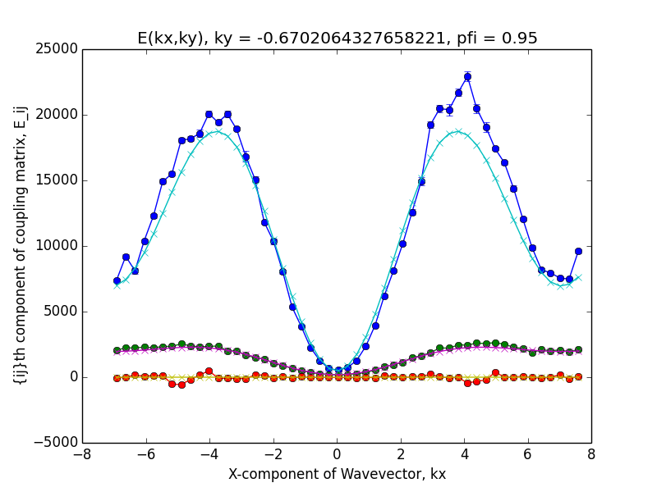
Notes:
Theoretical curves are obtained by fitting the entire function E_ij(kx,ky) over all available values of kx and ky to the relevant fitting parameters, of which there is only either one or two.
Phonon dispersion doesn't fit quite well as we get closer to the edge of the Brillouin zone, but that may be effective next nearest neighbor interactions
Bottom curve, phonon-libron coupling, is consistent with zero.

Slide 17
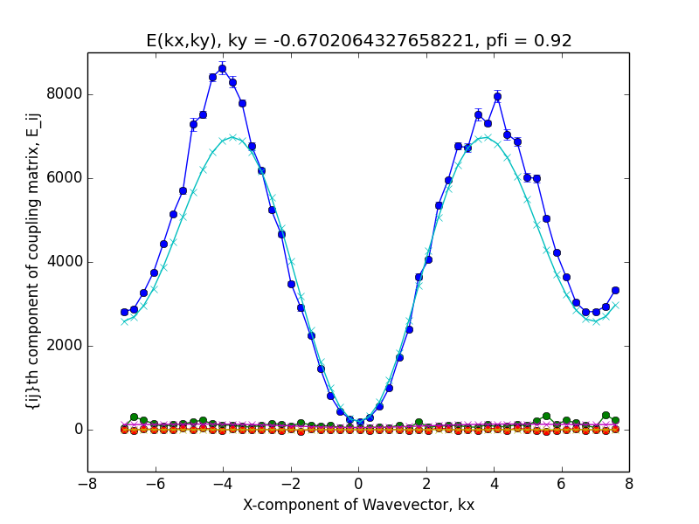
Notes:
Libron dispersion has gone down significantly but phonon dispersion is still there.

Slide 18
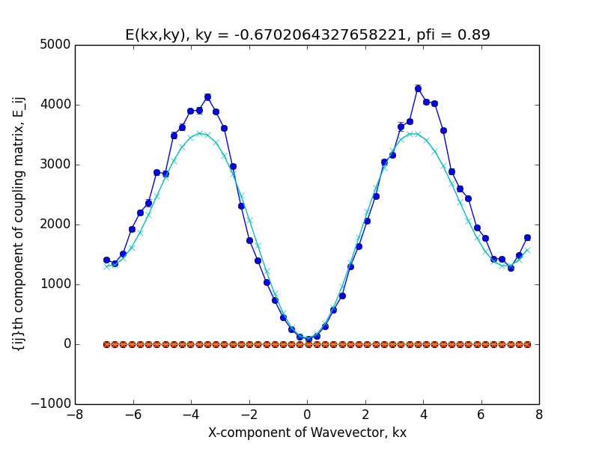
Notes:
Libron dispersion is extinguished

Slide 19
Libron's exit→restored symmetry
Somewhere between 89% and 92% is a transition where the libron no longer propagates at all.
Phonons are still there and correspond to the hypothesized wavevectors, so we still have a crystal structure.
Let's look more closely at the libron dispersion
Notes:
Close out the presentation and just go to the dropbox

Slide 20
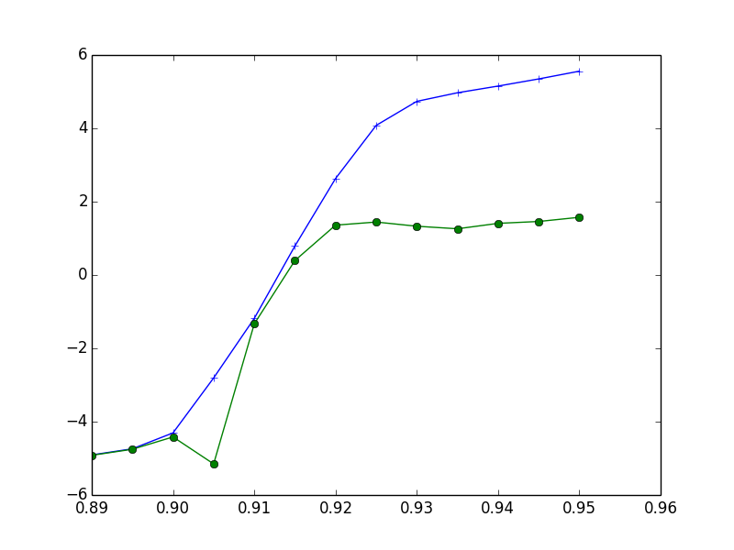
Log(coupling constants)
Packing fraction

Slide 21
Libron dispersion vanishes
The transition is not very abrupt, probably because I used a small system: 2500 particles.
Harmonic approximation breaks down near transition points. That is,
Technical issue: calculating and meaningful correlation functions.
  Angles don't wander too far away from their average values when things are pretty stiff.
  Obviously need to think harder near the transition point, if it ultimately matters at all

Slide 22
Future work
Coupling constants as a function of system size and packing fraction
Classifying order of the transition
  Critical exponents?
Rounded hexagons or other hard polygons
3-D: broken gauge symmetry is non-Abelian, which is a whole suite of complications, but probably rich behavior

